Slide 1

Paris Housing Price Prediction:
This study focuses on the analysis of typical house prices in Paris. Our project aims to predict Paris housing prices using computer analytics to understand the factors affecting house prices in the city.

Slide 2
Project Team
Trung Nguyen
Jayanth Bandaru
TBN140130
JXB230003
Bhavya Narendrabhai Patel
Sri Harsha Mahanti
BXP220032
SXM220117

Slide 3
Project Summary
1
Objective
To help people better understand the Paris housing market, whether they are agents, landlords, or potential buyers.
2
Approach
Using computer tools to categorize homes into types and dissect data with sophisticated analytics.
3
Goal
To simplify how the Paris housing market works for professionals and individuals looking for a new home.

Slide 4

Motivation Behind the Project
1
Parisian Real Estate
Exploring the Kaggle dataset to gain a detailed understanding of the various factors that impact housing prices in this well-known city.
2
Spatial Analysis
Understanding the various factors that affect property values in different districts.
3
Temporal Analysis
Identifying patterns influenced by economic shifts, seasonal variations, and broader market trends.

Slide 5
Data Description
Main Attribute
Numerical Attributes
Utilization
The price, which provides the estimated cost of housing in Paris.
Ten numerical and eight categorical attributes impacting the cost of housing in Paris.
Identifying the significant variables affecting the cost of housing.

Slide 6


Project Methodologies
Data Cleaning
BI Model

Slide 7

Exploratory Data Analysis
1
Checking for Null Values
Ensuring data integrity by eliminating null values and potential interference.
2
Overview via Boxplot and Histogram
Identifying problematic data and investigating correlations among variables.
3
Modeling
Creating a predicting model using linear regression and random forest techniques.

Slide 8
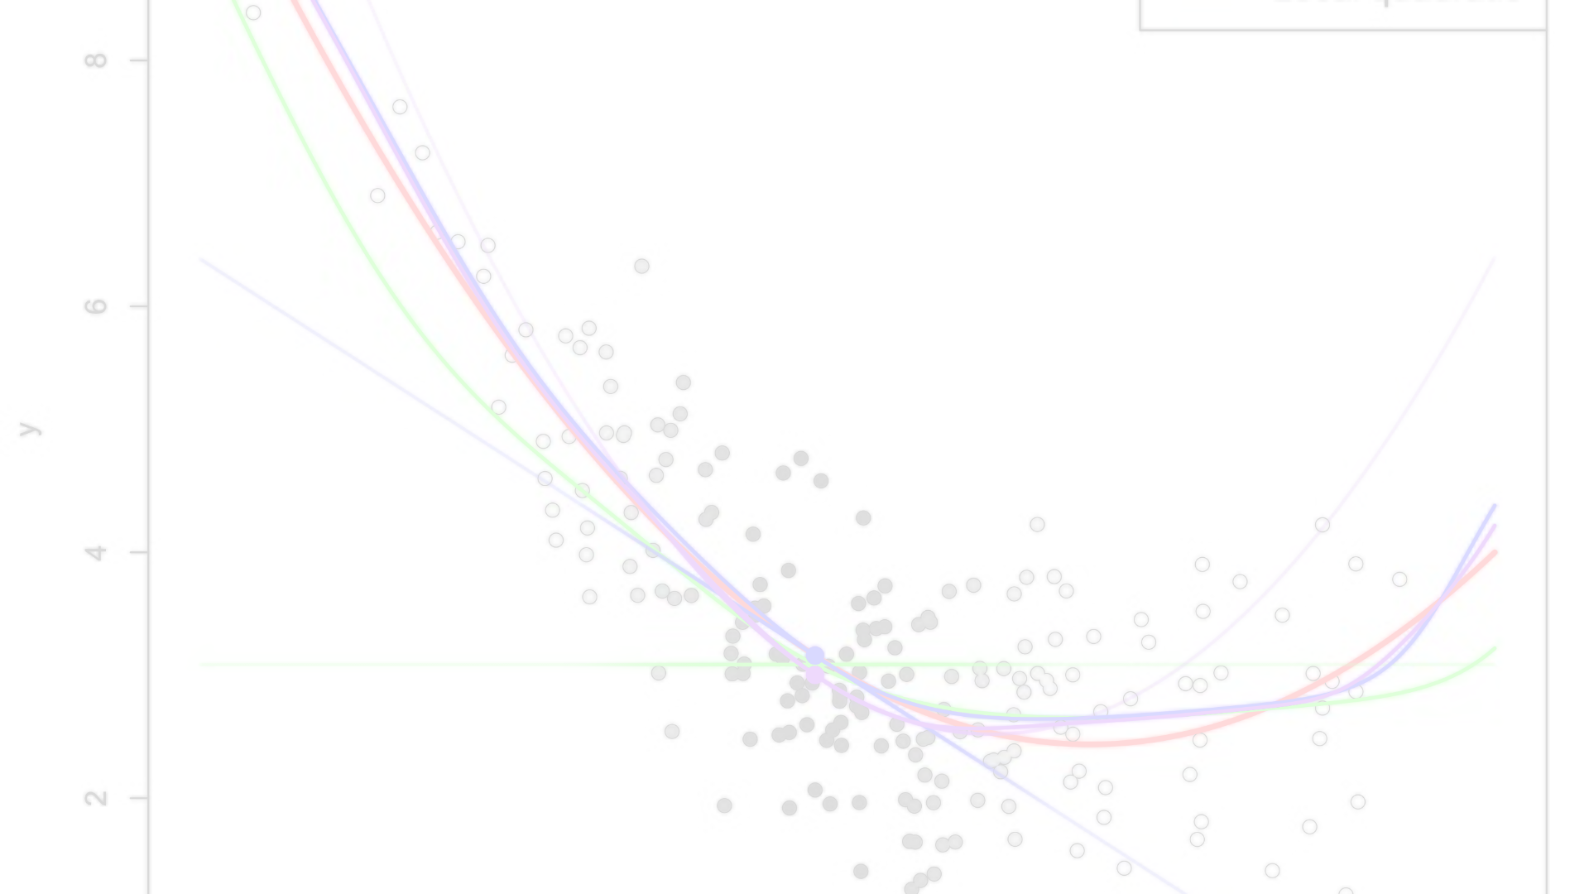
Managerial Implications
1
Better Choice Making
2
Agents and owners can make smarter pricing decisions.
3
Understanding the Market
4
Helping everyone better understand the Paris housing market.

Slide 9
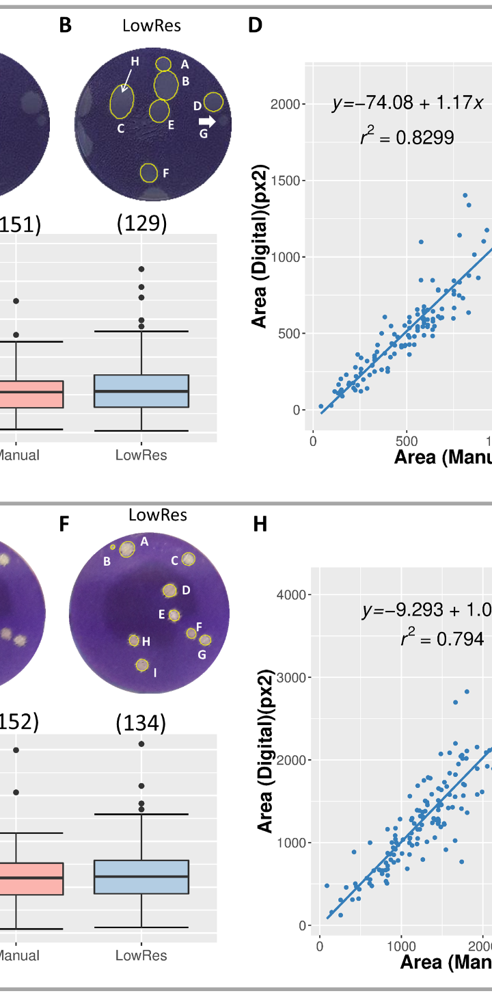
Statistical Analysis Methods
1
Traditional Regression
Gave us a decent rating of 73.41%
2
Random Forest Regression
Accuracy jumped to an excellent 99.40%
3
Conclusion
Random forest regression is the best method for predicting housing costs in Paris, providing a more reliable for accurate pricing.

Slide 10

References
1
Textbook
"Data Mining for Business Analytics: Concepts, Techniques, and Applications in R" by Galit Shmueli, Peter Bruce, Inbal Yahav, Nitin Patel, and Kenneth Lichtendahl.
2
Data Source
Kaggle: Paris Housing Data

